Slide 1
Muskegon Catholic Central Overview For Parents
Presented by
Muskegon Catholic Central
School Counseling Department

Slide 2
4x4 Semester Schedule
2 semesters/2 nine week quarters per semester
4 classes per day/86 minutes
Schedule changes – May thru June
8:00am – 3:00pm
Advisory: 11:00 – 11:30
Lunch: 11:30 – 12:00
16 classes per year
Mass Days are Wednesday from 9:22-10:22

Slide 3
Curriculum Overview 9-12

Slide 4
Progress Reports & Report Cards
You have access to current grades and attendance in PowerSchool
Check in often
Email teachers with questions or concerns
Don’t remember your account? Call Counseling
Report Cards
Elementary & Middle mailed home
High School online ONLY

Slide 5
MAP Test: 7th Grade
MAP assessments provide detailed, actionable data about where each child is on their unique learning path in the seventh grade. Measures of Academic Progress (MAP) tests present students with engaging, age-appropriate content. As a student responds to questions, the test responds to the student, adjusting up or down in difficulty. In this way, the test narrows in on a student’s learning level. The result is a rewarding experience for the student, and a wealth of detailed information for teachers, parents and administrators.

Slide 6
PSAT 8/9: Required
The PSAT 8/9 is the first exam in the SAT Suite of Assessments. Tightly aligned with the SAT, the PSAT establishes a baseline for college and career readiness as students enter high school. The PSAT 8/9 is designed for eighth- and ninth-graders. As part of the suite, the PSAT 8/9 will support all students with early feedback on the skills and knowledge that matter most for college and career success.

Slide 7
PSAT/NMSQT: Required for 10th & 11th Grade
The redesigned PSAT/NMSQT is an important part of the SAT Suite of Assessments, which also includes the SAT and PSAT 8/9. The Preliminary SAT/National Merit Scholarship Qualifying Test (PSAT/NMSQT) is a standardized test for tenth and eleventh grade students that provides first-hand practice for the SAT. It also gives students a chance to enter scholarship programs and gain access to college and career planning tools. The NMSQT taken in the junior year is the official route of entry to the National Merit Scholarship Program. This assessment supports a clear focus on the skills and knowledge that matter most for college and career success, and measures critical reading skills, math problem-solving skills, and writing skills.

Slide 8
SAT: Required for Juniors
The SAT and SAT Subject Tests are a suite of tools designed to assess academic readiness for college in the eleventh or twelfth grade. These exams provide a path to opportunities such as financial support and scholarships. The SAT and SAT Subject Tests keep pace with what colleges are looking for today, measuring the skills required for success in the 21st century. The SAT is a college admissions test that assesses knowledge of reading, writing and math.

Slide 9
ACT and AP: Optional
ACT - The ACT test assesses eleventh and twelfth grade high school students' general educational development and their ability to complete college-level work. The multiple-choice tests cover four skill areas: English, mathematics, reading, and science. The Writing Test, which is optional, measures skill in planning and writing a short essay. The ACT is a college entrance test and qualifying test for the Michigan Competitive Scholarship Program.
AP - The AP (Advanced Placement) Examinations are administered each year in May to juniors and seniors and represent the culmination of college-level work in a given discipline in a secondary school setting. The AP Exams test students' ability to perform at a college level. Most four-year colleges in the United States give students credit, advanced placement or both on the basis of AP Exam scores.

Slide 10
Extra-Curricular Activities
Encourage Students to get involved with their peers
Provide variety of experiences
Impact college/work application process
Examples:
Sports
National Honor Society
National Art Honor Society
Mission Trips
WINGS
Spring Musical
Student Council

Slide 11
Muskegon Catholic Central School Counseling Department
We are blessed with the opportunity to work with each of the students in grades 7th through 12th in the following counseling domains: Academic, College and Career Readiness, and Personal-Social.

Slide 12
Muskegon Catholic Central School Counseling Department
Mrs. Kelly Morell
School Counselor
kmorell@muskegoncatholic.org

Slide 13
Academic Domain
We begin to work with students in grade 7 on developing an Education Development Plan (EDP). This is intended to serve as a student’s roadmap throughout high school and help guide him/her into post-secondary education. Using the MAP, ACT, PSAT, and SAT data, we develop in collaboration with students a families, course schedules that will challenge each student to grow to his or her highest potential.

Slide 14
Creating an Education Development Plan
Three parts to an EDP include:
Career & Post-Secondary Education Planning Guide
Course Selection
E-Portfolio for college and scholarship documents as well as personal resume.

Slide 15
Graduation Requirements
A common set of required credits for graduation for all students based on the requirements set forth by the State of Michigan Department of Education.
Provides students the learning opportunities, knowledge, and skill sets they need to be successful in college or the workplace.

Slide 16
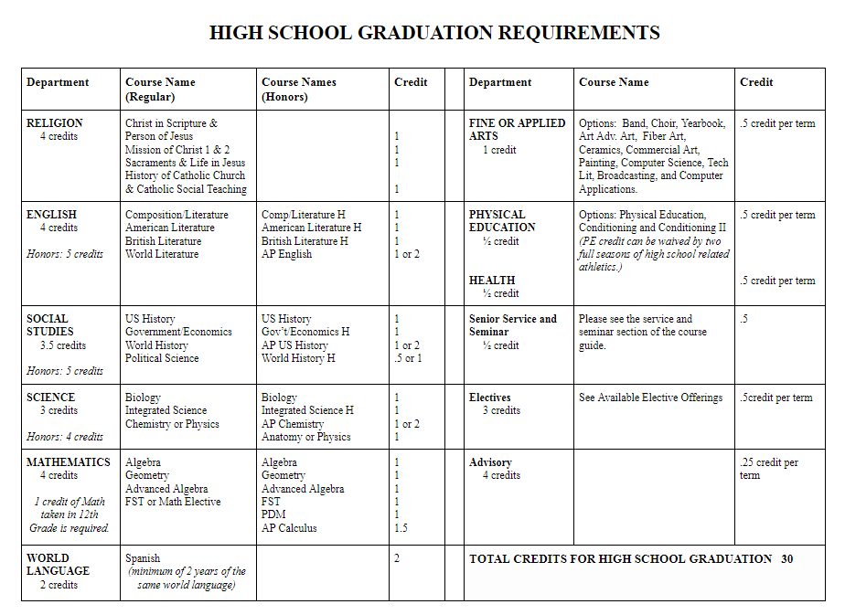
Graduation Requirements

Slide 17
Dual Enrollment
Dual Enrollment schools include, but not limited to: Aquinas, Muskegon Community College, GVSU, Baker College.
Available for all 9th-12th grade students
Able to take up to 10 total classes during HS
Earn high school and/or college credit while in HS
Must be a class that we do NOT offer or if there is a conflict in the Muskegon Catholic schedule
May NOT be a PE, Health, Hobby, or non-academic class
Student MUST be in good academic standing with Muskegon Catholic before dual enrollment will be considered
The Dept. of Treasury will pay for the tuition, unless your child fails their college course.

Slide 18
Muskegon Area Career and Technical Center
Vocational/Professional programs
1 or 2 year opportunities
Junior and/or Senior Year
Senior credit in English, Math, or Science is available depending on program
http://www.muskegonisd.org/ctc-new/programs/
Allied Health Technology
Auto Collision/Refinishing
Auto Service Technology
Business Careers
Catering and Culinary Management
Computer Aided Design
Construction Trades
Cosmetology
Criminal Justice
Electrical/Computer Technologies
Environmental/Veterinary Sciences
Graphic Production Technologies
Health Science Academy
Internet, Network and Security Technologies
Machining/Engineering Tech
Welding Technology

Slide 19
College & Career Readiness
98% of the Muskegon Catholic Central graduates matriculate into post-secondary education. Students are given the opportunity to take the MAP, ACT, Compass, PSAT 8/9, PSAT, and SAT tests during their high school years. I will work closely with students as they go through the college application and selection process.

Slide 20
Six Career Pathways

Slide 21
Advisory &
Career Planning
Students are assigned to an advisor who advocates for them and ensures that they are on track to successfully complete the requirements of their educational development plan. This is also an opportunity for weekly monitoring of grades, standardized test score analysis, introduction to 21st century skills, and other general homeroom responsibilities.
Career and Education Exploration
Career Matchmaker
Learning Styles Inventory
Study Skills
Post-Secondary Investigation and Planning
Financial Aid
Career Planning
Career and Life Goals
Resume Building
Self-Assessment of activities and abilities
Volunteer Hours
Work Experience
Awards, Certificates, and Honors

Slide 22
College Admissions
Transcript Information
GPA, course selection, trends
High School Testing
ACT & SAT
Extracurricular Activities
Sports, community service, theater, student council, etc.
Recommendations
Counselors, teachers, clergy, supervisors, coaches, mentors, etc.

Slide 23
Personal-Social Domain
Students go through a tremendous change as they progress through their middle and high school years and transition into young adults. Often times, students experience personal struggles in the classroom and in their relationships with others. I have an open door policy and am available to talk with them and help them work through certain life issues. I also have several references for outside services if needed. Please know that I am here to help each child reach his or her fullest academic and spiritual potential.

